Slide 1

FINAL YEAR PORJECT
NEWS MAVENS
Freelance Platform for Jouralists

Slide 2
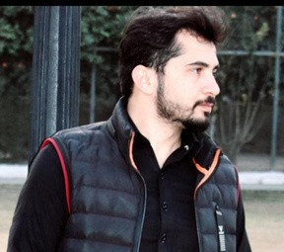
Meet Our
Group
Members
Usama Shafique, Team Lead
F-20154 (UET-40)
Semster 06 (SE-02)
BSc Software Engineering
Asjadullah
F-201016 (UET-31)
Semster 06 (SE-02)
BSc Software Engineering
Rameen Naveed
F-20143 (UET-42)
Semster 06 (SE-02)
BSc Software Engineering
Supervised By
Engr Fahim Muhammad Khan
Software Engineer & Lecturer

Slide 3
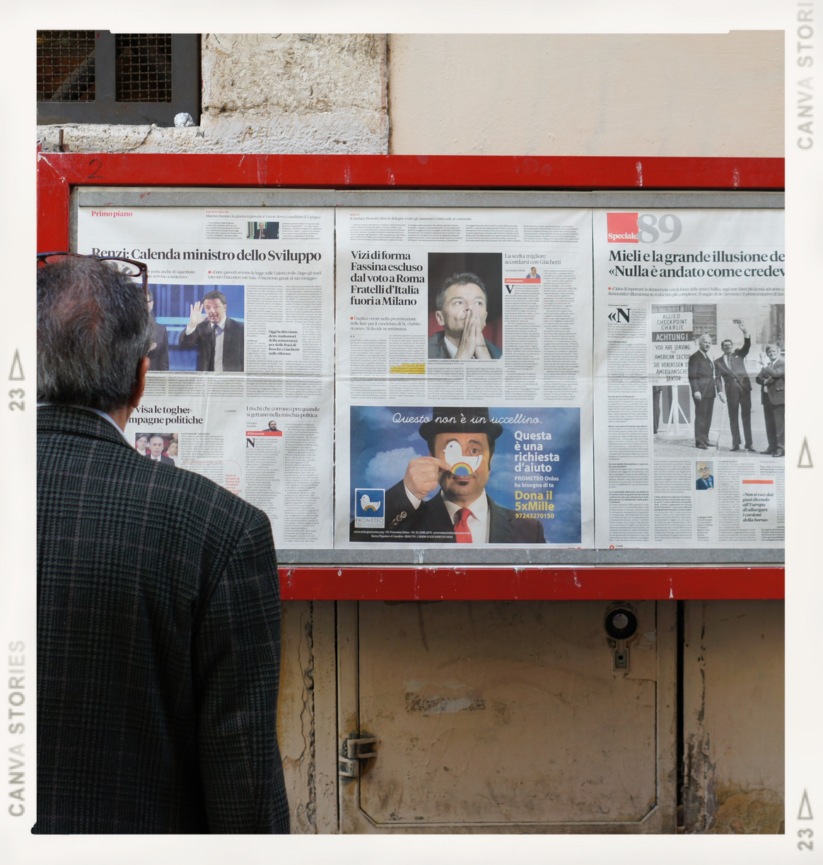
INTRODUCTION
News Mavens will be the first and best platform for everyone to keep themself up to date about daily news reports .
Our platform will provide remote work for journalists as many big companies or media houses can hire them on remote basis work (small projects, contract basis).

Slide 4
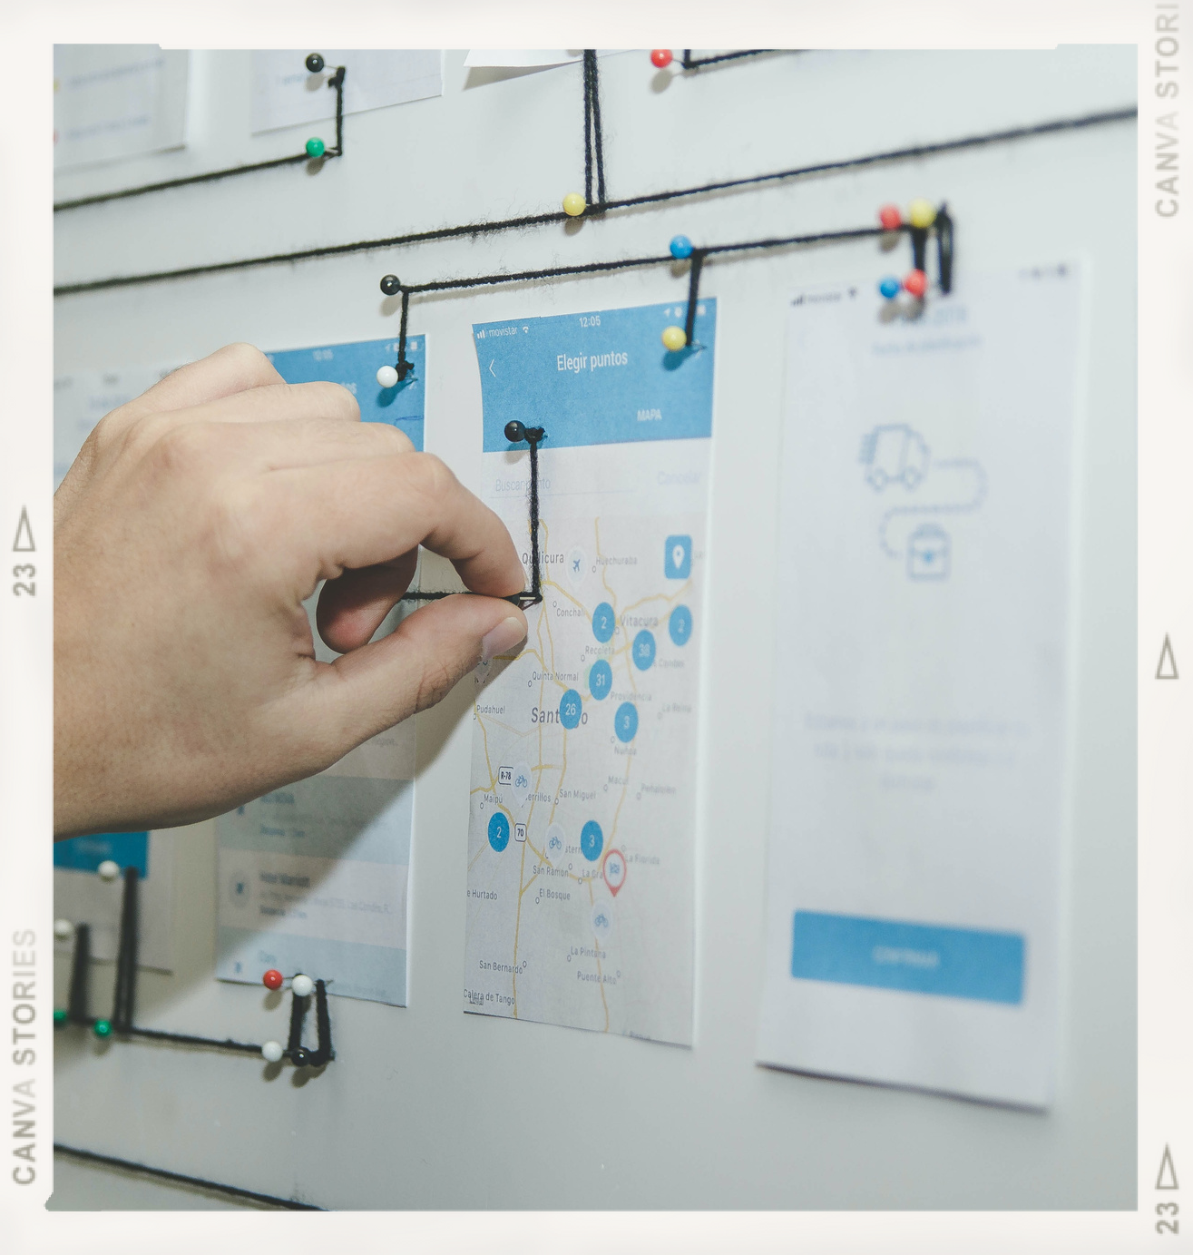
PROJECT DOMAIN
we will use modern web technology for the development and maintenance of the project . It will be web and mobile based .It will provide journalists with great job opportunities . They can share their news in many forms and write blogs.
It will help the media industry to improve their careers. It will be very useful to the marketer to engage with their specific audience through us.

Slide 5



Our Goals
Freelance Platform
To Provide the Journalists community with freelanace remote work opportunity and to reduce the Job insecurity for journalists.
Preferred Guy for Companies
To provide the Media houses, News channel and online newspapers companies with best journalist
Up-to-Date News updates
·to keep everyone up to date about daily news reports by providing anauthentic and reliable news

Slide 6





Problem Identification
what cause us to think about this?
It is not surprising that job security is one of the most challenging aspects of being a journalist nowadays. As we know the news industry would provide no job security for the next five years. 2019 brought both digital and print media several rounds of layoffs, furloughs, and closures. Entire publications also ceased to exist and many journalism careers ended. by the beginning of 2020, the media industry had already lost 8000 jobs which covid was one of the main reasons. People nowadays rely on social media news that isn't authenticated and doesn't have a reliable source. And media houses can't find the right person because of the market gap

Slide 7

PROPOSED SOLUTION
Job security is one of the most challenging aspects of being a journalist nowadays Our platform will provide remote work for journalists and provide them vast range of opportunities for jobs. Users will have an authentic and reliable news platform they can trust.

Slide 8


Scope Of Project
what is News Mavens going to do?
This freelance platform will play important role in the journalist's community. Buyers will have a job posting option to get what they want if they can't find the right person by searching. Journalists will also be provided with bidding options on jobs posted by buyers Journalists will share their news reports, blogs, videos news, interviews, vlogs, and columns on NewsMavens.
They will be paid if their news goes on trending using the CPM method. The news journalist's shares on our platform will be included in their portfolio so to make their profile strong for buyers to understand what they do and in what they are experts. Buyers can hire a journalist on a single or multiple project basis or short-term, long-term, and contract basis. Journalists can work on a single or multiple project basis or on short-term, long-term, and contract bases.

Slide 9
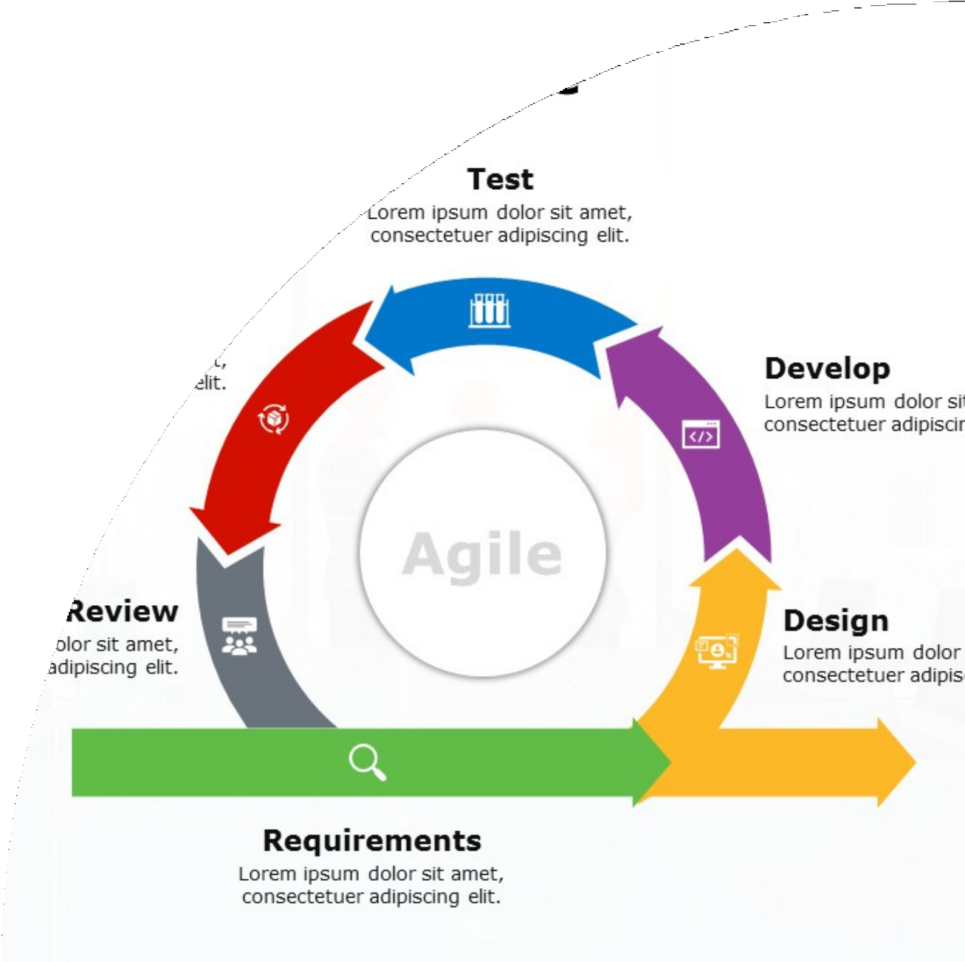
Methodology
Agile
with the help of these we are going to built this great thing
We are using agile methodolgy because our project is open ended . It will require changes on daily or maybe weekly basis so for that reason we prefer agile.

Slide 10
Technologies To Be Used
HTML,CSS,JS
Bootstrap
React & React Native | ExpressJS & NodeJS Realm & Firebase
WebPack
Github & Gitbash | GIT Google Analytics
Cludfare CDN Ahrefs
Appium
Acunetix
WebLoad
Digicert
Cloudflare server
Nginx Heap.io
Google Workspace google search console

Slide 11
THANKS FOR WATCHING

